Slide 1
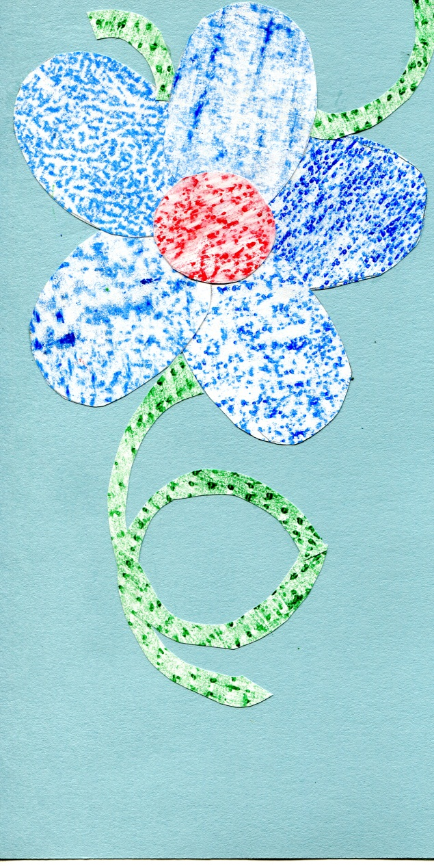
Mosaic wall hanging

Slide 2
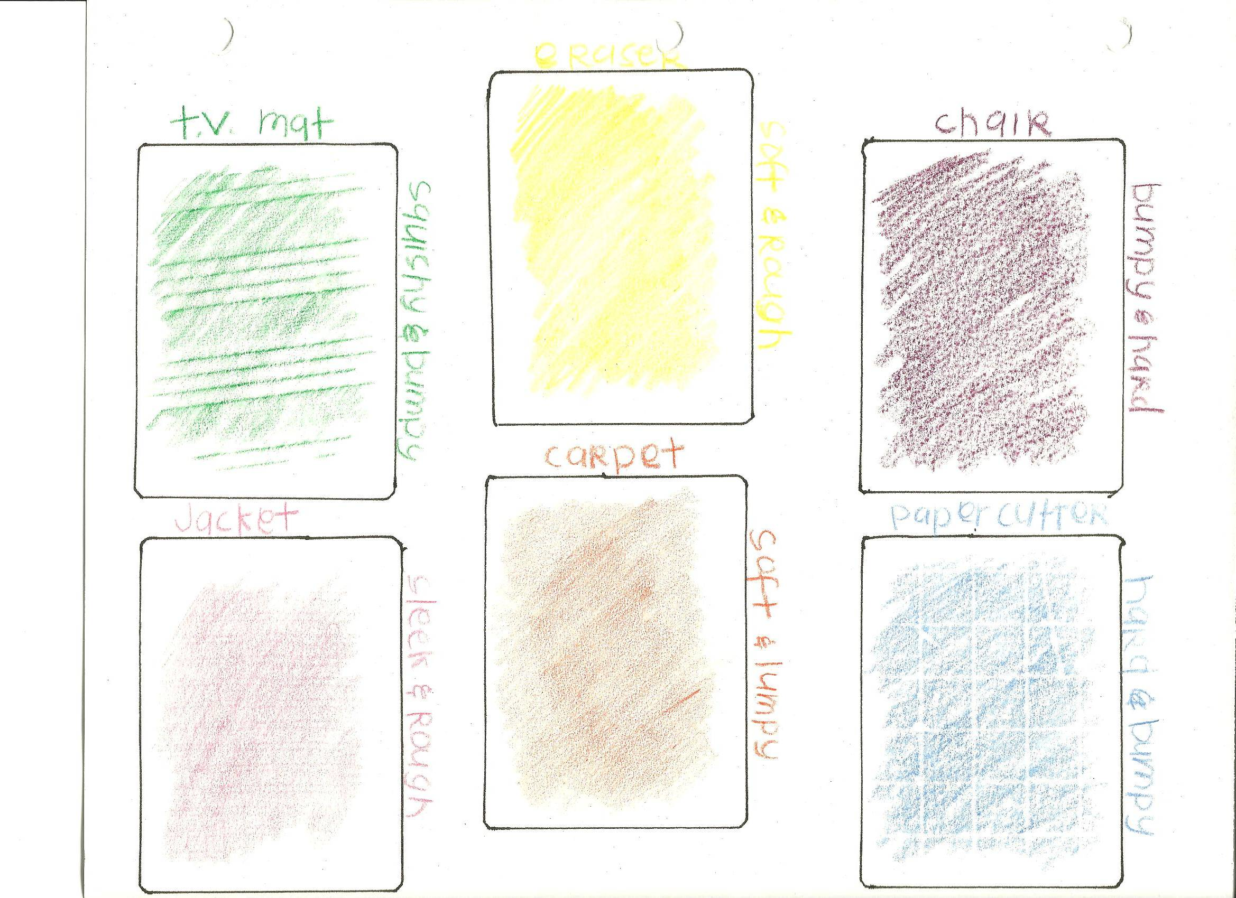

Slide 3
Texture Rubbing
- Fold a sheet of paper into six squares.
- -Make 6 texture rubbings by placing your paper over a surface and rubbing it with a crayon.
-REMEMBER the object of each texture rubbing AND think of adjectives used to describ the texture.
Once you return, continue on with the Mosaic assignment.

Slide 4
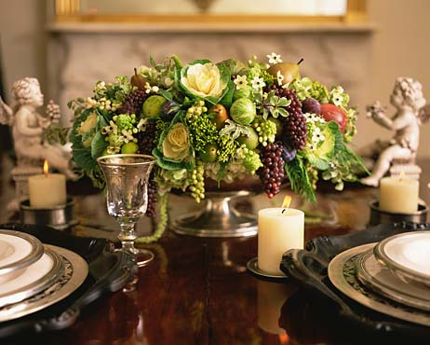
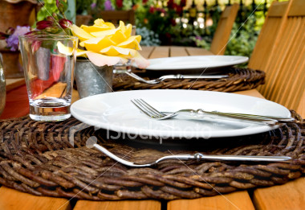
TEXTURE
Describe these textures
Deals with the appearance and feel of a surface.
May be rough, smooth, shiny, dull, hard, soft, etc..
Adds variety and interest to designs

Slide 5
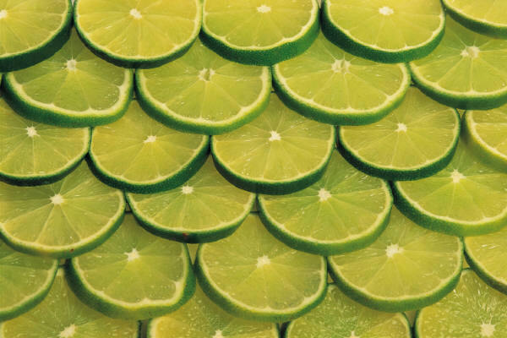
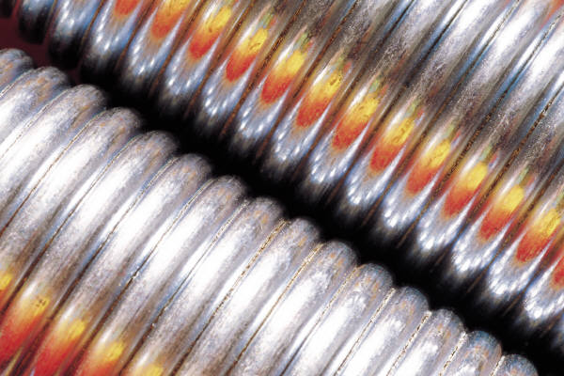
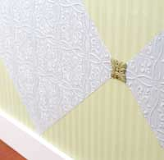
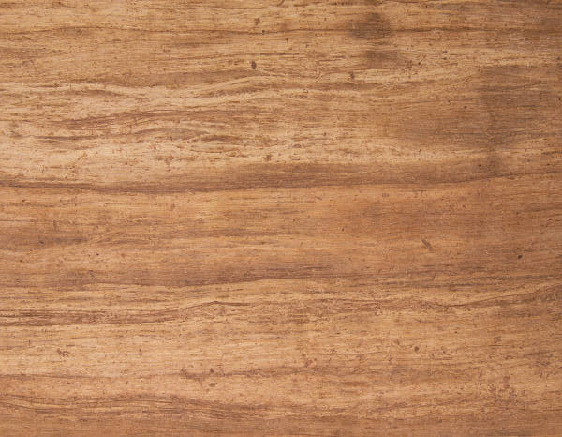
Texture
Three Categories of Texture:
Tactile—the feel of a surface
Audible—the sound a surface makes when rubbed
Visual—the appearance of a surface

Slide 6
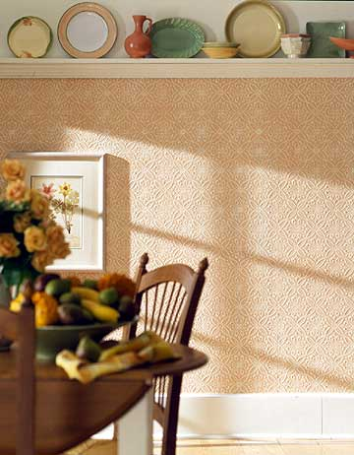
Visual Textures is a Pattern or Decorative Design
The arrangement of motifs to create a unified design.
4 types of pattern/design
(review from unit 1)
Naturalistic
Stylized / conventional
Abstract
Geometric
Visual Texture is everywhere

Slide 7
http://www.youtube.com/watch/?v=7HIn3X14inI Visual texture is everywhere

Slide 8
Texture and Patterns add variety and visual interest to designs

Slide 9
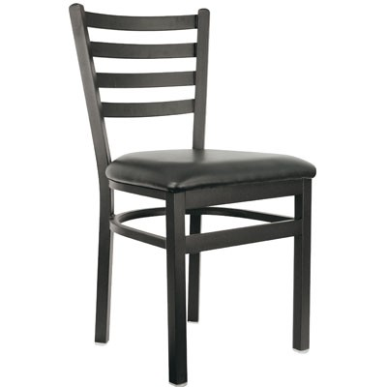
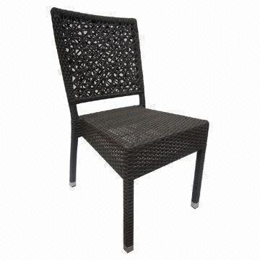
It affects the overall appearance of an object and a room
Appearance and size is affected by the light’s reflection which is influenced by the texture of the item.
Muted textures and dull colors do not reflect light therefore advancing in and making a space or object appear smaller.
Shiny textures and bright colors reflect light and recede out making the object appear larger.
Black wicker chair vs. black metal chair

Slide 10
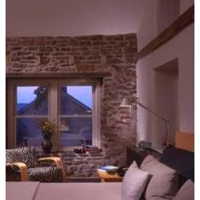
Affects the overall size of an object and room.
Rough, heavily textured walls appear to advance in and will make a room appear smaller.
Rough textured or bulky furniture = larger appearance in size and shape.

Slide 11
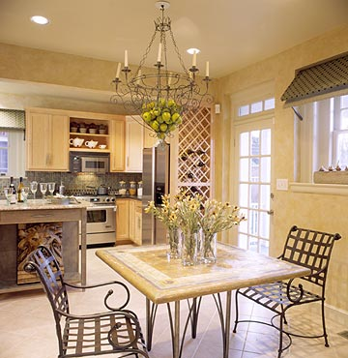
Walls or objects with little or no texture appear to recede back making a room or object appear larger.

Slide 12
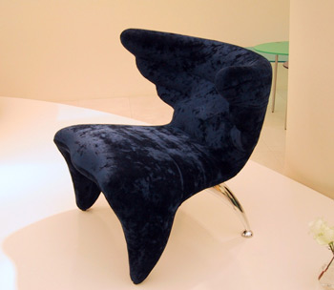
It influences the way people feel and act in a room.
Plush carpet and furniture with soft fabric = comfort
Nubby rough = ruggedness and stability
Smooth velvets and heavy brocades = luxury
Glass, metal, and stone = coolness

Slide 13
2 types of TEXTURE

Slide 14
Formal Textures
Shiny, refined and smooth are typical formal textures.
Reflect light so colors appear lighter, brighter, and more intense. Rooms and objects appear larger.
Used in high-style interiors and rooms.

Slide 15
INFORMAL TEXTURES
Absorb light so colors look darker and less intense.
Objects and rooms can look smaller depending on the texture.
Gives a rustic, cozy, comfortable feeling

Slide 16
To achieve a feeling of correctness in Combining Texture and Patterns:
Maintain a consistent mood.
Formal naturalistic will not work with informal geometric.
The size of the pattern should correspond to the size of the room and its windows.
Small scale patterns often used in cozy rooms
Large scale patterns for spacious rooms. These make a room appear smaller.
Use a variety of sizes of relatable patterns to create interest.
Evaluate the placement of emphasis and avoid too many patterns in one area.
1 bold pattern on a large area works better than 2-3 smaller patterns scattered throughout the room.
Identify the color scheme of the pattern and follow it.

Slide 17
Texture Rubbing Mosaic

Slide 18
Texture Assignments
8. Texture Rubbing and mosaic
Arrange the shapes on colored construction paper to create a mosaic.
No mounting or title. Write on the back about your mosaic, the textures used, and adjectives describing the textures.
9. Textile Furnishing
2 sofas and 2 different textures, patterns and or style (informal/formal).
Explain what you did.
10. Texture Board;
Using your favorite room picture, identify how you think this room could be different by varying the textures. If the room is formal, how could you make it informal by changing its texture and if its informal, how could you make it formal?
Choose 3 objects or coverings in the room (upholstery/fabric, window coverings, wall treatments, accessories, flooring…) and find actual samples of what you could use instead of what is in the picture. Remember to use variety in your textures.
-Fold a piece of cardstock in half and properly mount your samples to the left side of the page. On the right side of the page explain what the actual object is and how you chose to modify it. Also explain how this changed the appearance and feel of the object area or room.

Slide 19
The rest of the unit assignments
11. Design Question and Answers
12. Favorite Room analysis from Unit 1

