Slide 1
LINE

Slide 2
Definition of LINE
An element in a room that moves the eye by connecting two points
Describes the outline of a shape
Separates or unifies space
Each type creates its own feelings or messages

Slide 3
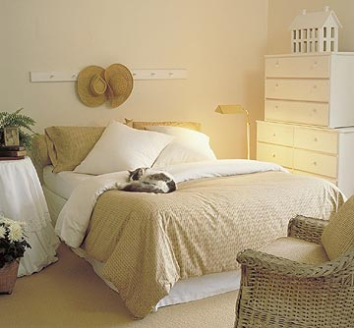
Line Directions - Horizontal
Follow the horizon _______________
They create a feeling of restful, quiet, peace, relaxing, sturdy, informal – especially if they are long. (Calm Lake)
Ex: Low ceilings, broad openings, stretched out furniture

Slide 4
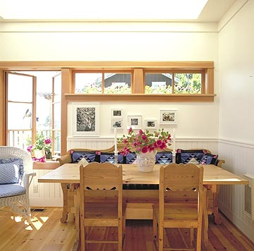
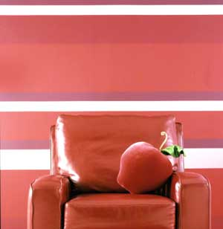

Slide 5
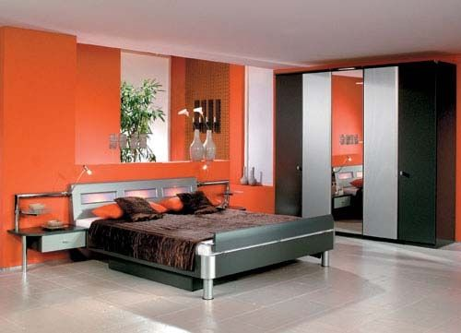

Slide 6
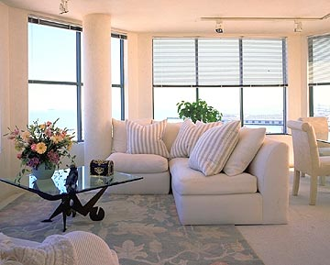
Line Directions - Vertical
Run straight up and down
Create a feeling of strength, dignity, formality, loftiness, assurance, height, and emphasis.
Ex: High ceilings, tall doors and windows, upright furniture placement.

Slide 7
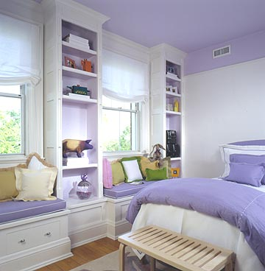

Slide 8
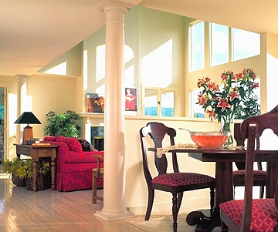

Slide 9
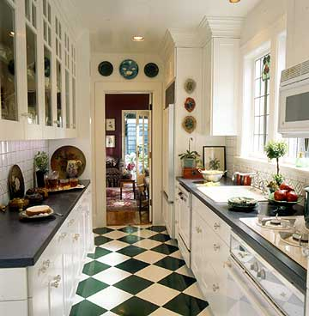
Line Directions – Diagonal / Angled
Slants or run at an angle
Suggest direction, movement, activity, and energy.
Ex: Sloping ceilings, furniture placement

Slide 10
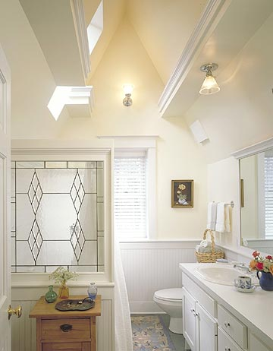

Slide 12
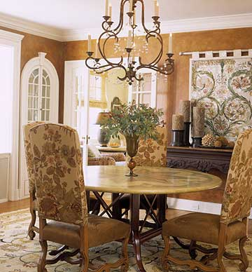
Line Directions - Curved
Change direction gradually and continuously along their path.
Feeling of playful, graceful, and feminine,
Upward curves – uplift and inspire
Horizontal curves – gentleness, femininity, relaxed
Large Downward curves – express seriousness and sadness
Small curves – playfulness and Wide and sweeping – appear graceful
Tight and spirals – feeling of liveliness.

Slide 13
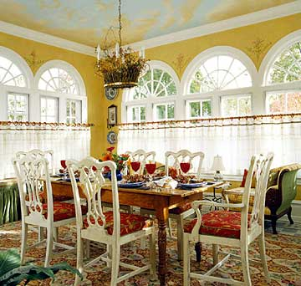

Slide 14
Group Design Challenge
Your entryway in your new home extends 2 stories high.
Suggest furnishings, flooring, ceiling paint, and wall coverings that will visually minimize the height and the great open space.
Describe your design process including what lines would be created in this area and how they would help.
Present your design ideas to the class.

Slide 16
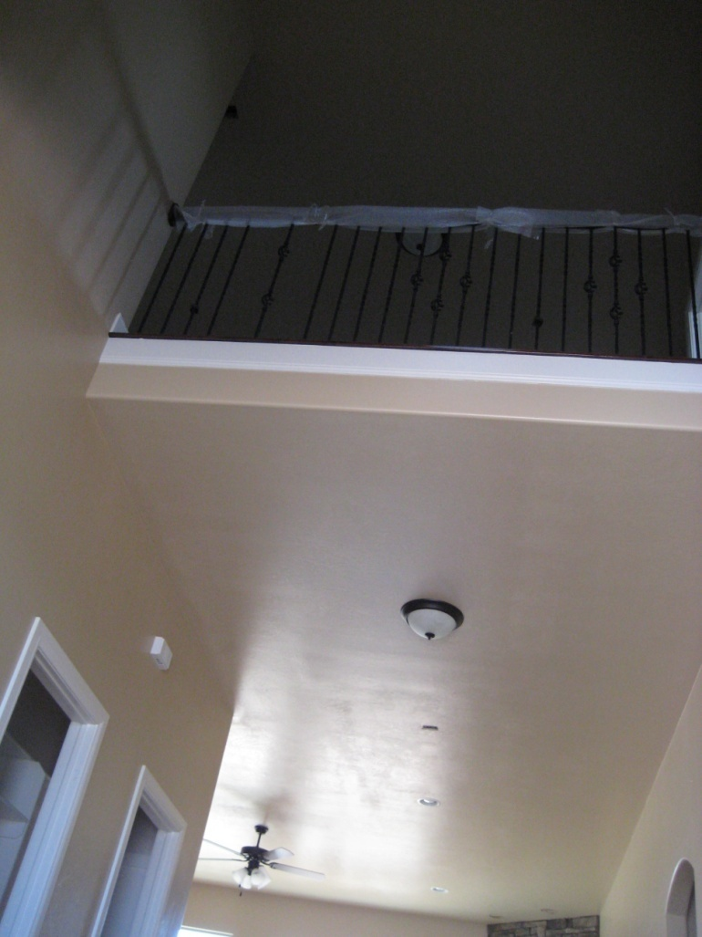

Slide 18
YOUR ASSIGNMENT
Create a word document.
Find the following items for the entryway. Your goal is to minimize the height of the great open space.
Find items using google images
Paste items onto the word document.
Describe your design process including what lines would be created in this area and how they would help.
You will present your design ideas to the entire class.

Slide 19
Find the following items:
Furnishings
Flooring
Ceiling paint color
Wall coverings

